Slide 1
HapPy World
Determining the effect of a person’s physical environment on their perceived happiness.

Slide 2
Andrew Fisher
Analyzation/Visualization
Kelly Fry
Analyzation/Visualization
Simon McKamey
Cleaning/Restructuring data
Kyle Jamar
Analyzation/Visualization
Taylor Johnson
Analyzation/Visualization
Notes:
Taylor

Slide 3
Datasets
World Happiness Report:
Survey of global happiness
From 2015 to 2019
Measurements:
Country/Region
Happiness Rank
Happiness Score
GDP Per Capita
Life Expectancy
Family
Government Corruption
Generosity
Freedom
World Bank Group - Climate Change Knowledge Portal:
Historical climate data
From 2015 to 2016
Measurements:
Average rainfall by Country
Average temperature by Country
Notes:
Taylor

Slide 4
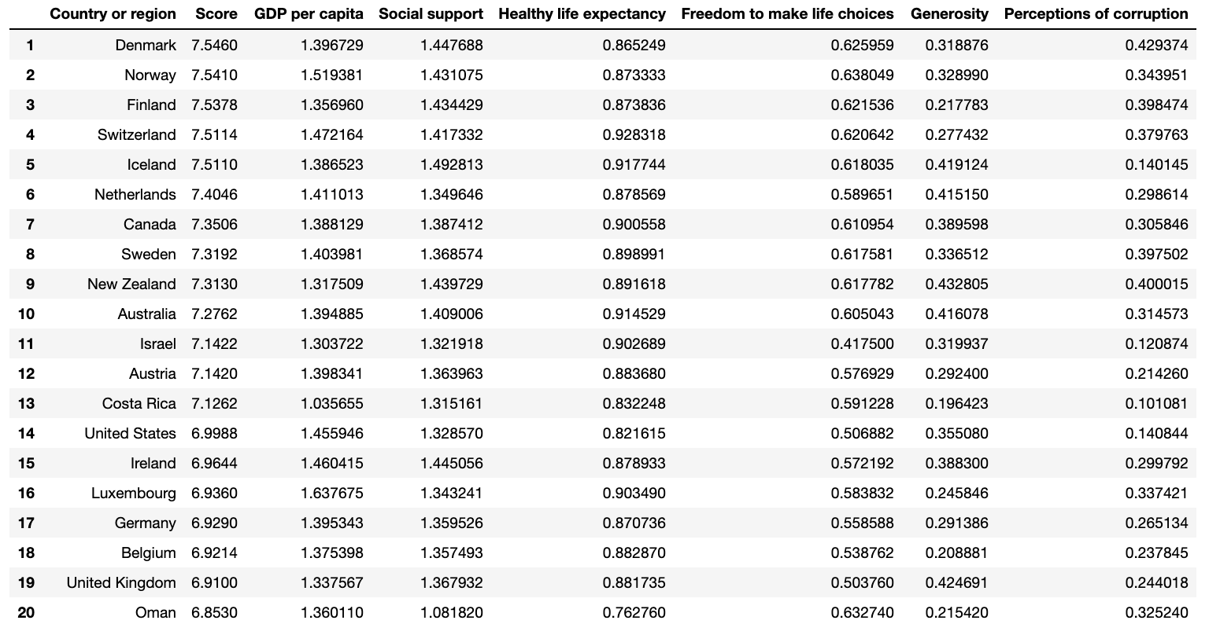
A look at our dataset
Notes:
Taylor

Slide 5
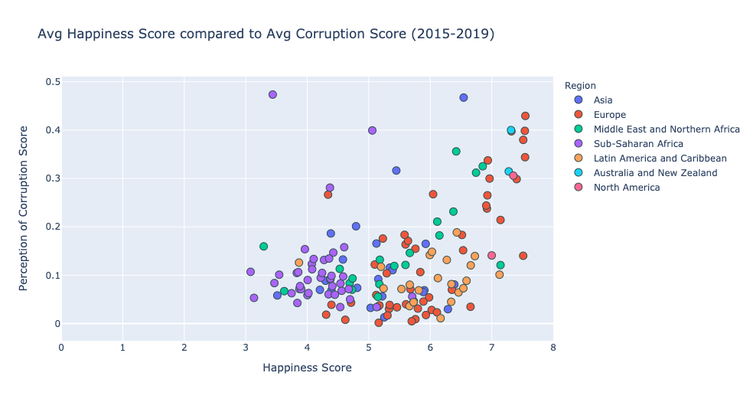
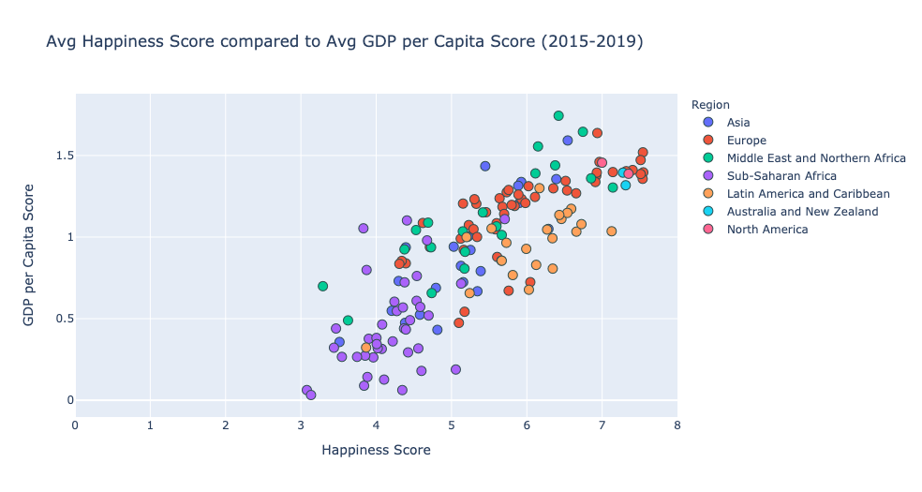
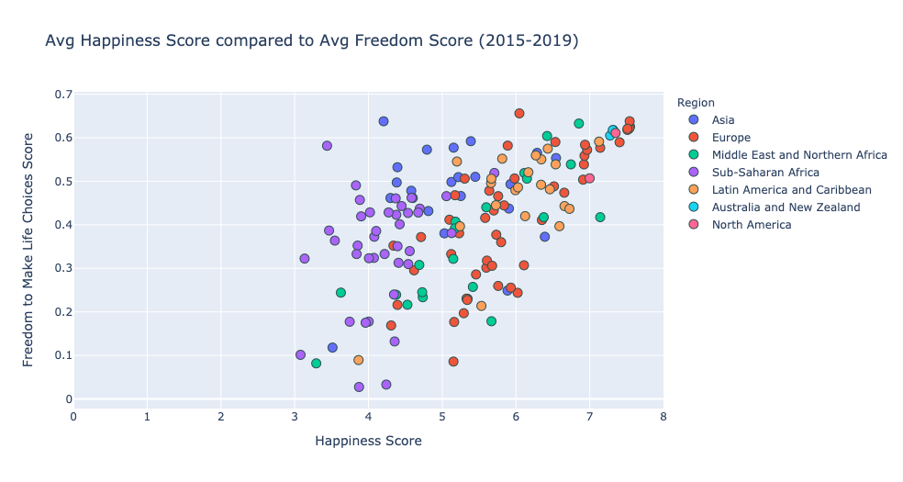
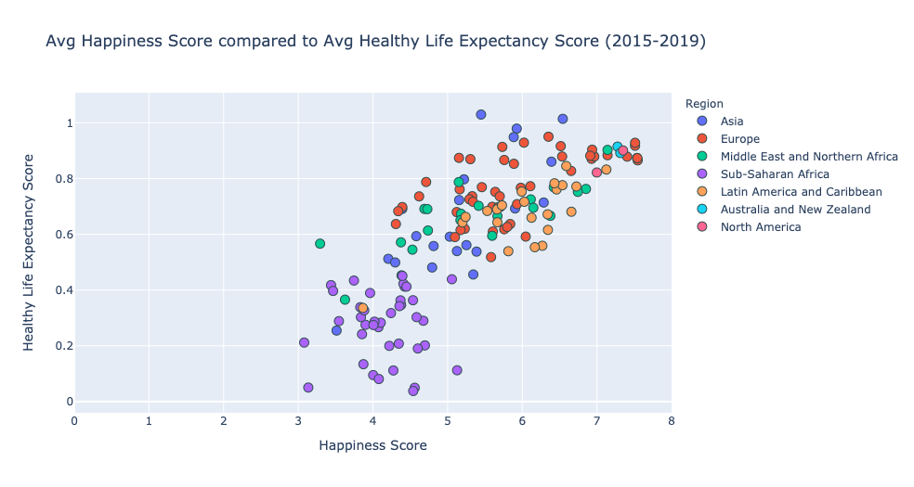
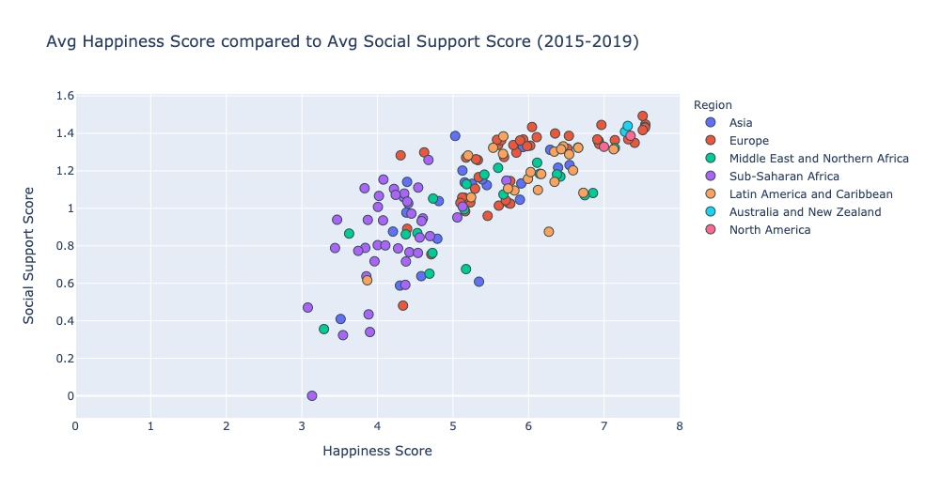
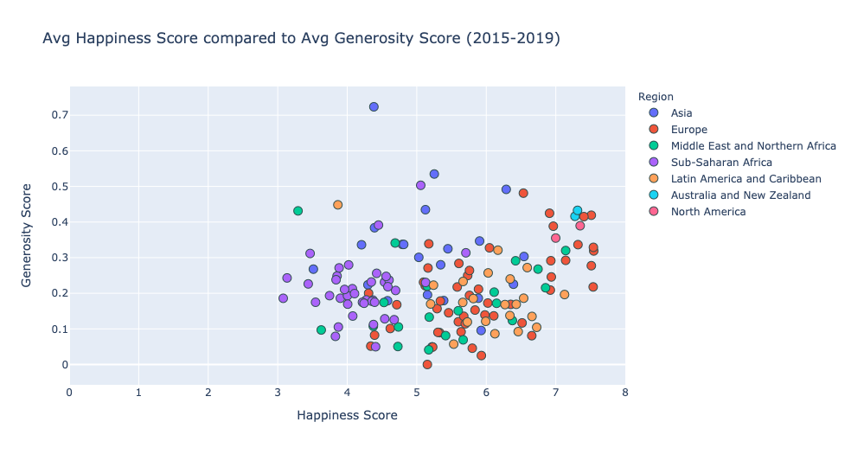
What correlates the most to happiness?
Notes:
Kelly

Slide 6
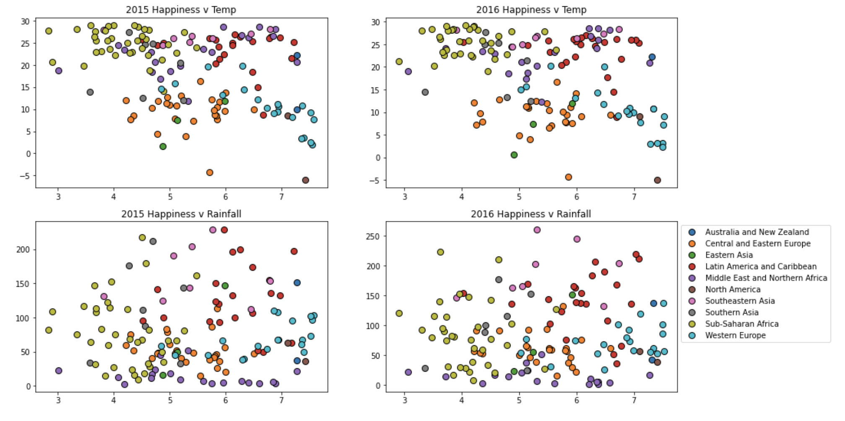
What about the weather?
Notes:
Kelly
Correlation between weather and happiness was not significant

Slide 7
GDP
Based on our analysis, GDP per capita has the highest correlation to happiness.
Notes:
Andrew

Slide 8
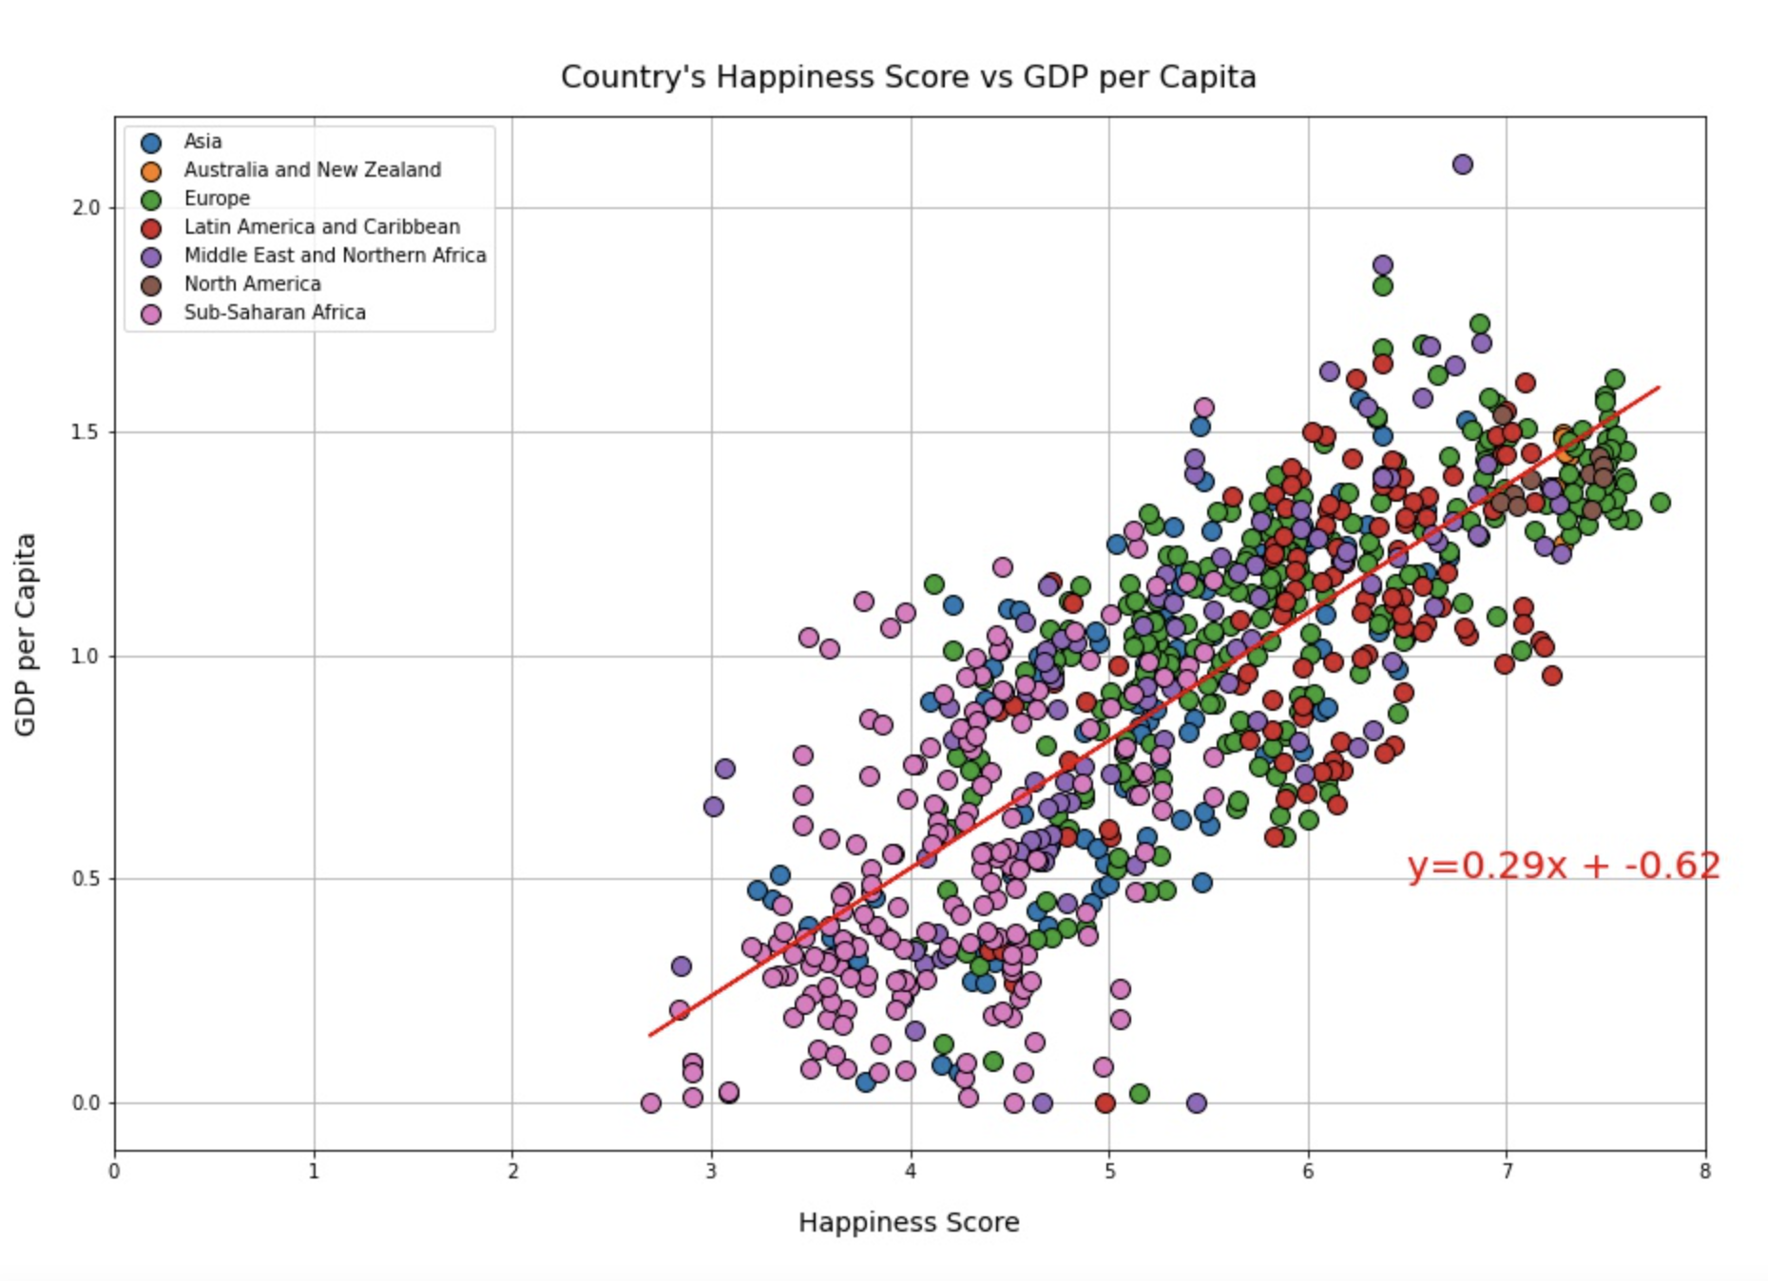
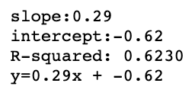
Notes:
Andrew

Slide 9
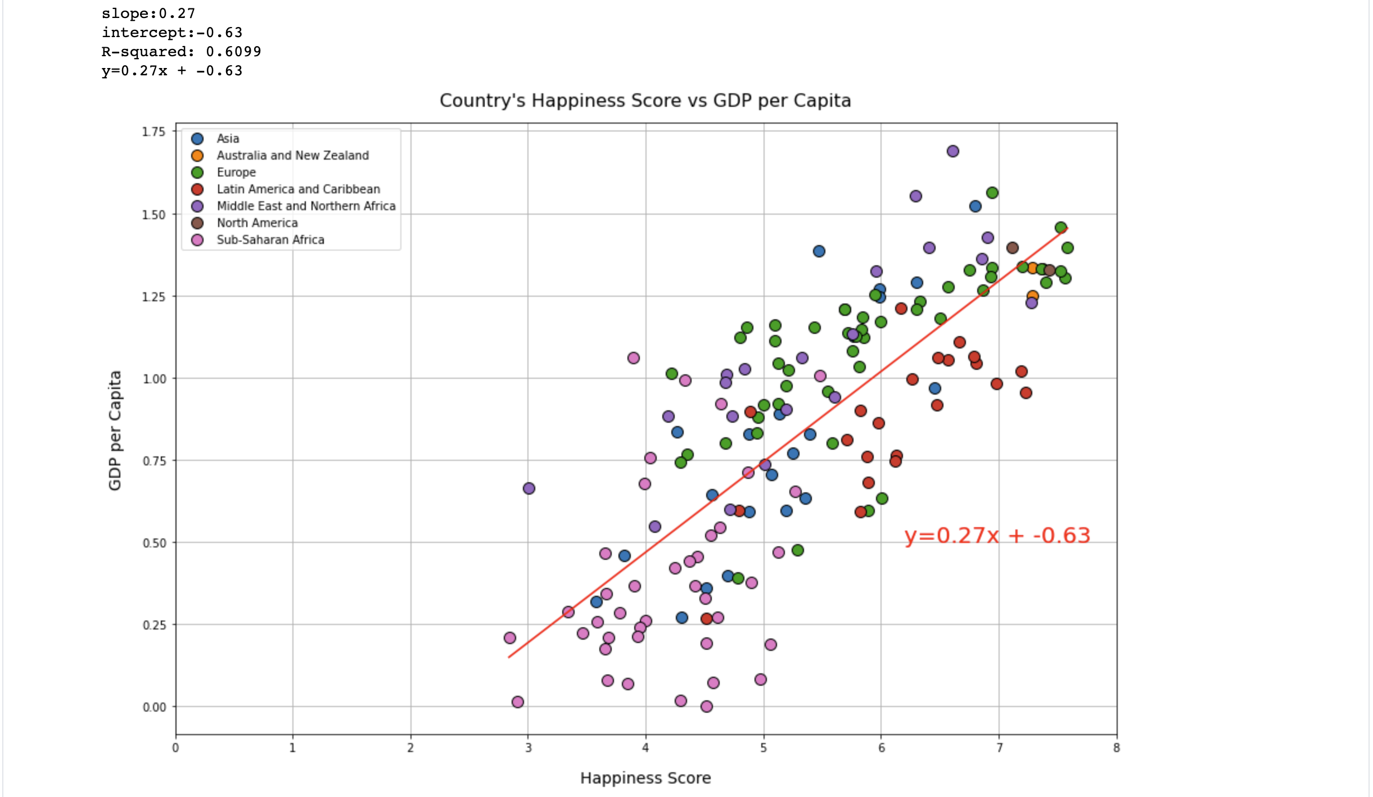
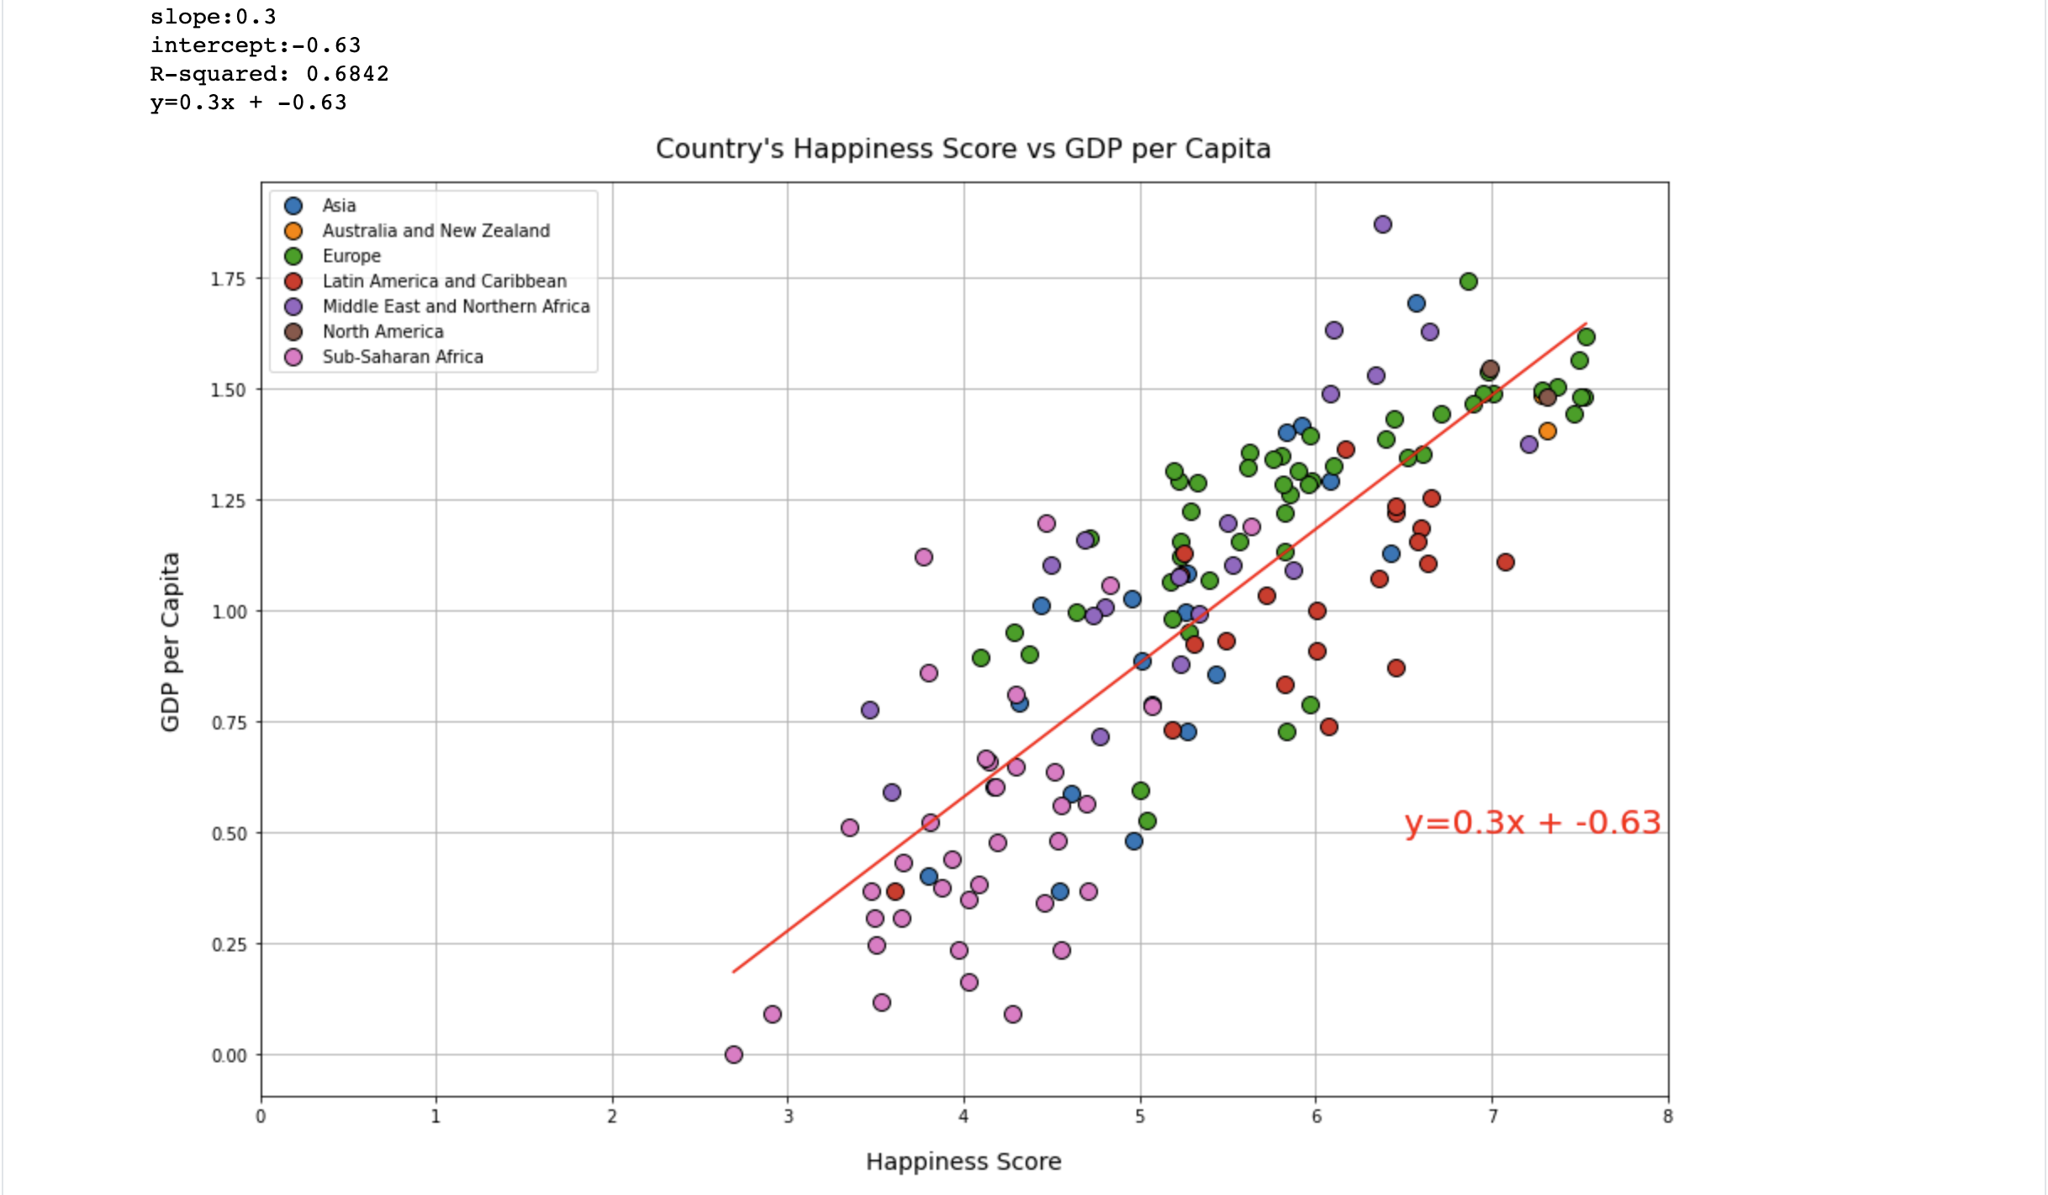
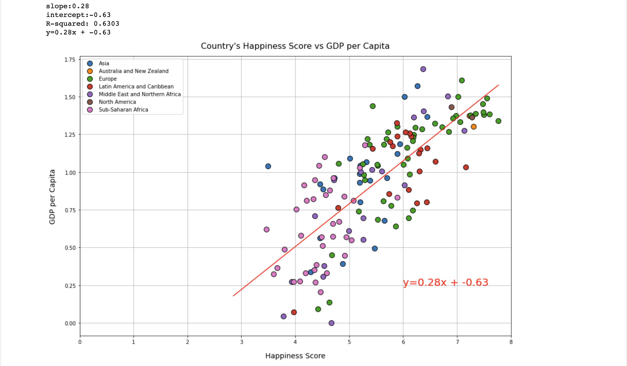
Year-by-year correlation between GDP and Happiness
2015
2017
2019
Notes:
Andrew

Slide 10
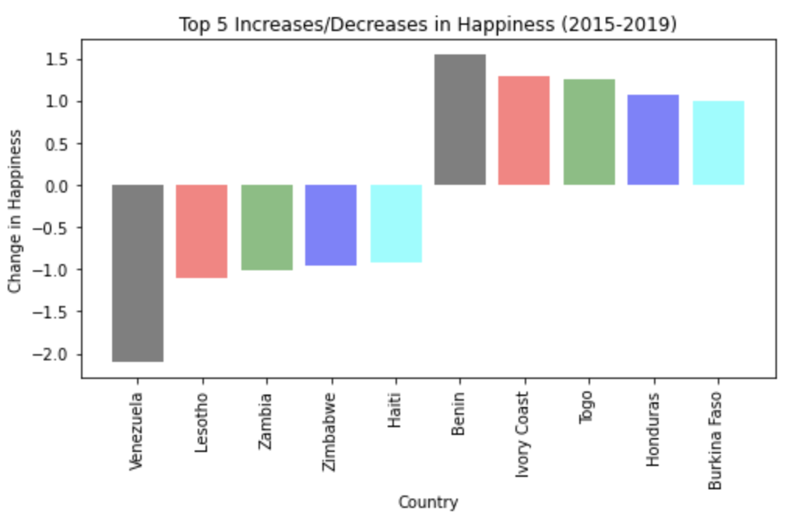
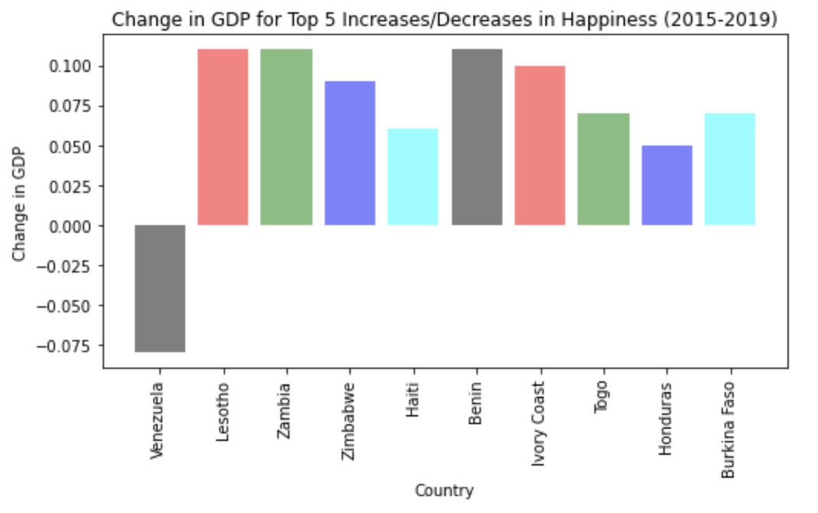
Ten Mood Changes
Notes:
Kyle- countries with the greatest mag. of change, corresponding change in GDP

Slide 11
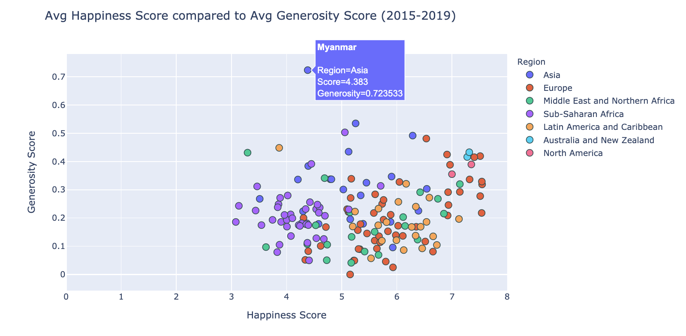
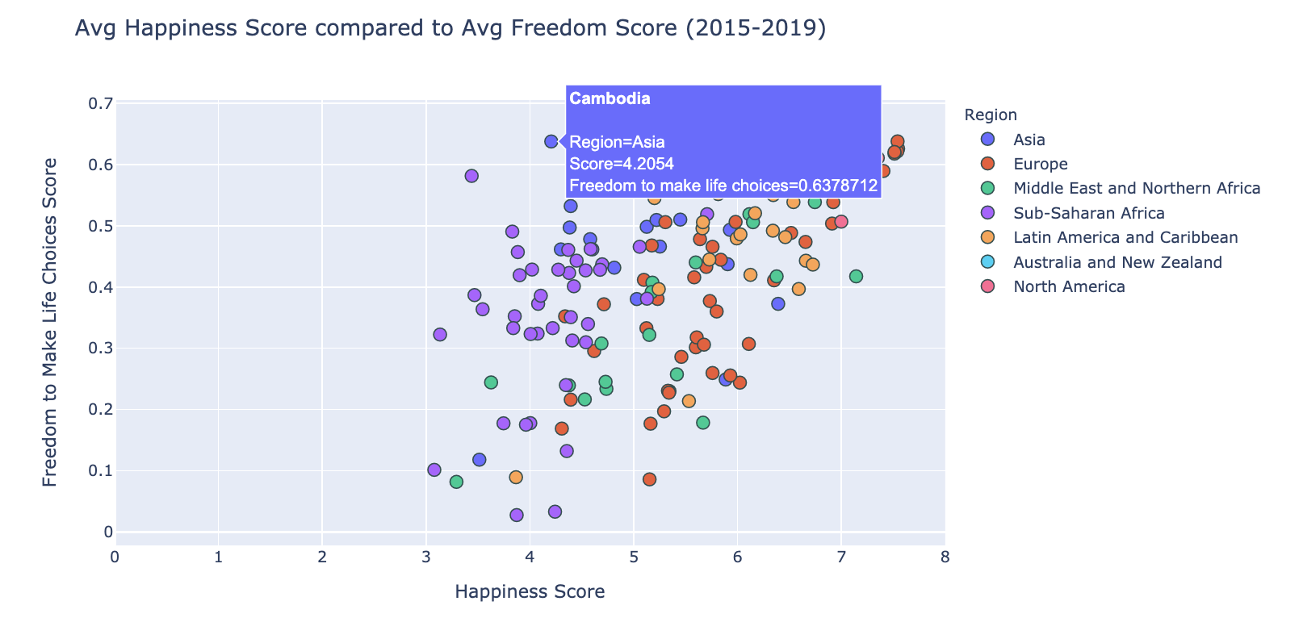
Interesting Cases
Using interactive plot
Generosity
Highest overall: Myanmar
Lowest overall: Greece
Freedom
Top 10 avg. freedom score: Cambodia
Lowest overall: Sudan, Angola, Syria
Notes:
Simon - outliers/other factors

Slide 12
Further Questions
Measuring categories by region instead of country
Freedom and Social support were more closely aligned with the Top 20 happiness scores
Predictions for 2020 without COVID
Notes:
Simon - further questions

Slide 13
Works Cited
World Happiness Report
FAQ
World Bank Group - Climate Change Knowledge Portal
Project Proposal

